Slide 1
Earthquakes
Chapter
3
Learning outcomes: 1.1, 2.1, 2.8

Slide 2
At the end of this chapter, you will be able to:
3.1 Describe and explain earthquake activity.
3.2 Describe the distribution and measurement of earthquakes.
3.3 Compare two different earthquakes.
3.4 Describe the economic and social impact of earthquakes.
3.5 Describe short-term and long-term responses to earthquakes.

Slide 3
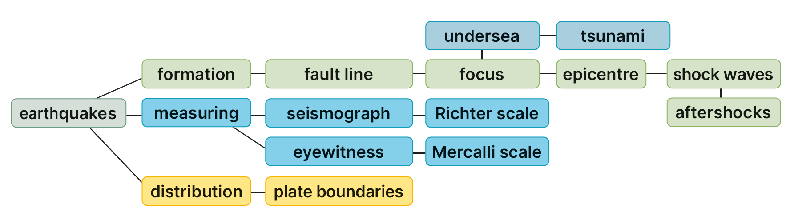
Keyword connections

Slide 4
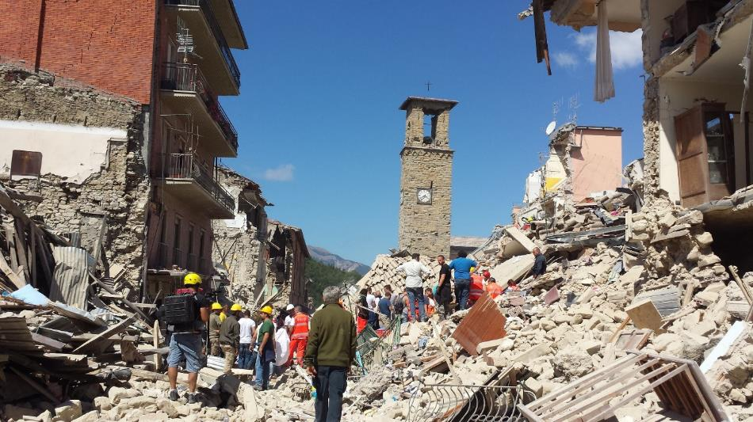
3.1 Describe and explain earthquake activity.
1. An earthquake is a sudden shaking of the Earth’s crust.
2. Earthquakes are caused by two plates slipping past each other.
3. Earthquakes can cause huge damage to people and buildings.
Discuss with a classmate why the damage in the photograph occurred.
Discuss also why you think some buildings collapsed and others did not.

Slide 5
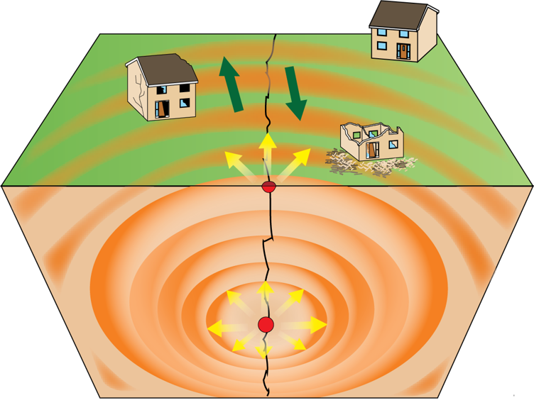
3.1 Describe and explain earthquake activity.
1. Fault lines are long, deep cracks in the crust that separate different plates. As the plates move, they sometimes get stuck. Energy builds up, the plates slip suddenly and violently past each other.
2. The point where the earthquake begins underground is called the focus.
3. When this happens, shockwaves or tremors move through the Earth, shaking rocks as they go. This is an earthquake.

Slide 6
3.1 Describe and explain earthquake activity.
4. The epicentre is the point on the Earth’s surface directly above the focus.
5. Tremors spread outwards from the epicentre. Often there are aftershocks that follow the main earthquake. These can often cause more damage as buildings are weakened. Places closest to the epicentre suffer more damage.

Slide 7
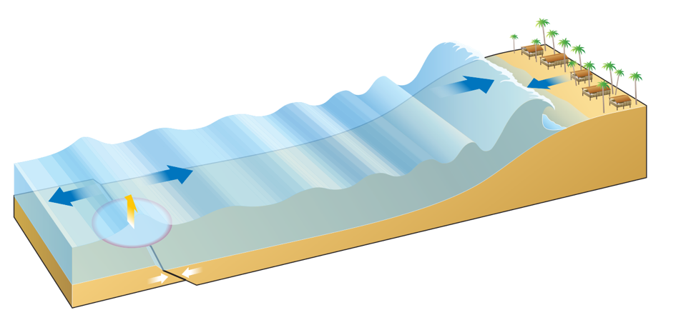
3.1 Describe and explain earthquake activity.
Tsunami
If an earthquake occurs under the ocean, it can produce a tsunami.
A tsunami is a huge wave that moves quickly towards the shore.
Tsunami waves can be up to 40 m in height.
It can cause major damage and loss of life.
Example: Japanese tsunami of 2011 killed 16,000 people.

Slide 8
3.1 Describe and explain earthquake activity.
Go to Section 3.1 on page 9 of your Skills Book.

Slide 9
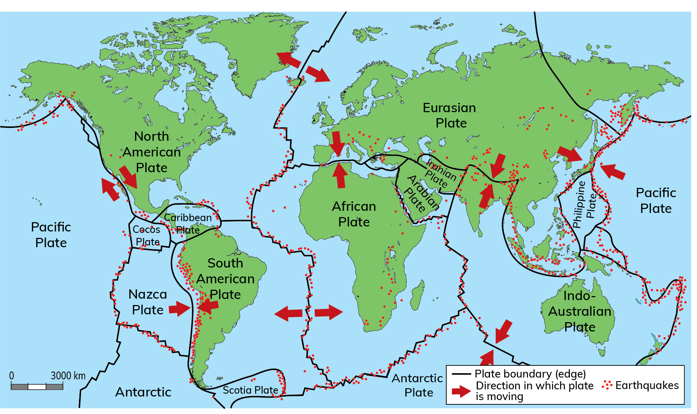
3.2 Describe the distribution and measurement of earthquakes.
1. Earthquakes occur at all
three types of plate
boundaries:
Constructive
Destructive
Conservative
2. One of the most famous fault lines in the world is the San Andreas Fault, California, USA. It is the boundary between the Pacific and American plates and runs for 1,300 km.

Slide 10
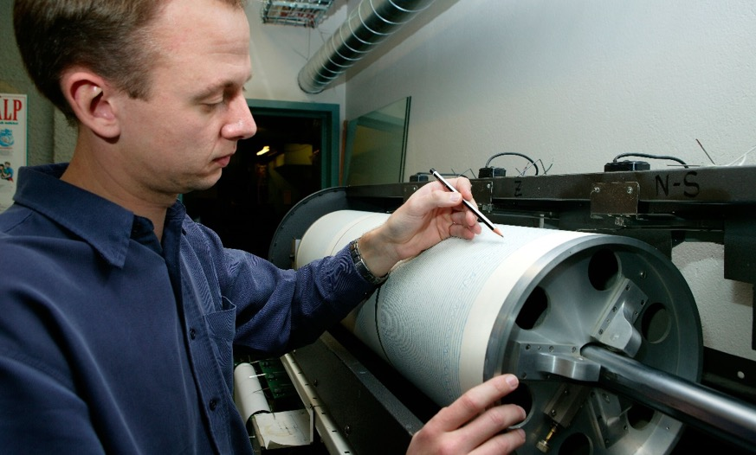
3.2 Describe the distribution and measurement of earthquakes.
1. A seismograph is an instrument used to measure and record earthquakes.
2. The Richter scale registers the strength, or magnitude, of an earthquake.
This scale ranges from 1 to 10, and an increase of one unit on the scale means that an earthquake is 10 times more powerful.
The higher the number an earthquake measures on the Richter scale, the greater the destruction it causes. The Richter scale is a scientific measurement of earthquake magnitude.

Slide 11
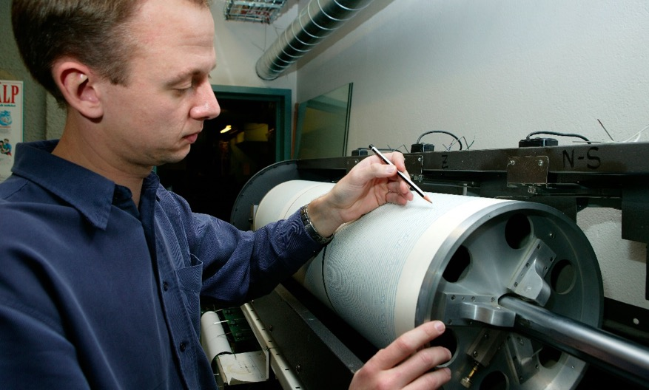
3.2 Describe the distribution and measurement of earthquakes.
3. The Mercalli scale is also used and is based on eyewitness observations.
It ranges from I to XII
(I = no damage; XII = total destruction).
It measures the damage caused by earthquakes. It was developed by Giuseppe Mercalli in 1902.

Slide 12

3.1 and 3.2
1. What is the difference between the focus and the epicentre of an earthquake?
2. What is the difference between the Richter scale and the Mercalli scale?
3. What is a tsunami?
4. How does plate movement explain why earthquakes happen?

Slide 13

3.1 and 3.2
Higher-order questions 1
1. What do you think was the magnitude of the earthquake that happened in the town shown in the photograph?
2. Why do people continue to live in earthquake zones?
3. What is the connection between plate tectonics and earthquakes?

Slide 14
3.2 Describe the distribution and measurement of earthquakes.
Go to Section 3.2 on page 10 of your Skills Book.

Slide 15
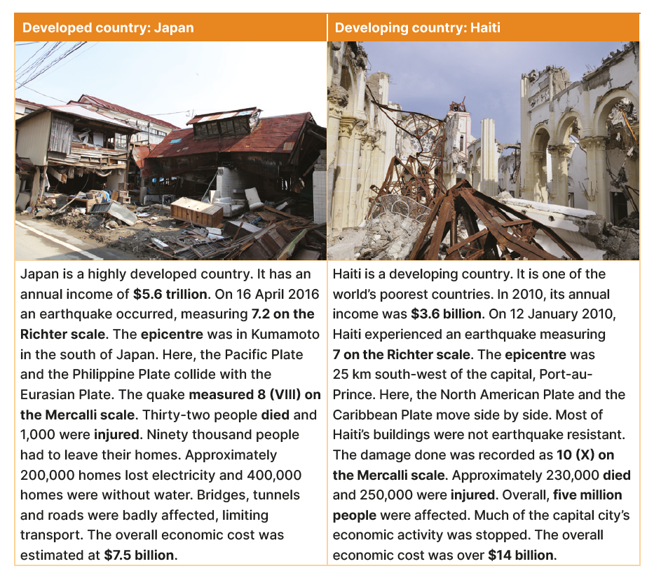
3.3 Compare two different earthquakes.

Slide 16

3.3 Compare two different earthquakes.
1. How big on the Richter scale were the earthquakes in Japan and Haiti?
2. How many people died in each earthquake?
3. What was the economic cost of each earthquake?
4. Which of the two earthquakes caused the most damage?
5. Explain the difference in damage done between the two earthquakes.

Slide 17
3.3 Compare two different earthquakes.
Higher-order questions 2
Look at Figure 3.4 on page 23 of your Textbook and look at the world map on page 430. Identify the locations of Japan and Haiti. Explain how each location helps us understand earthquake activity in the country.
2. Which of the two countries – Japan or Haiti – were able to rebuild more quickly after their earthquakes? Explain your answer.
3. Which scale – Richter or Mercalli – is better for understanding earthquakes?

Slide 18
3.3 Compare two different earthquakes.
Go to Section 3.3 on page 10 of your Skills Book.

Slide 19
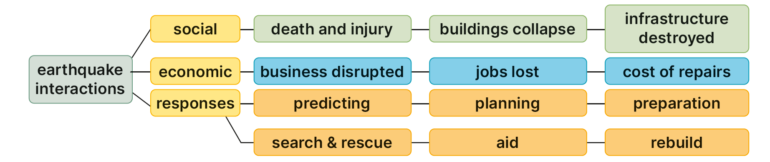
3.4 Describe the economic and social impact of earthquakes.
Keyword connections

Slide 20
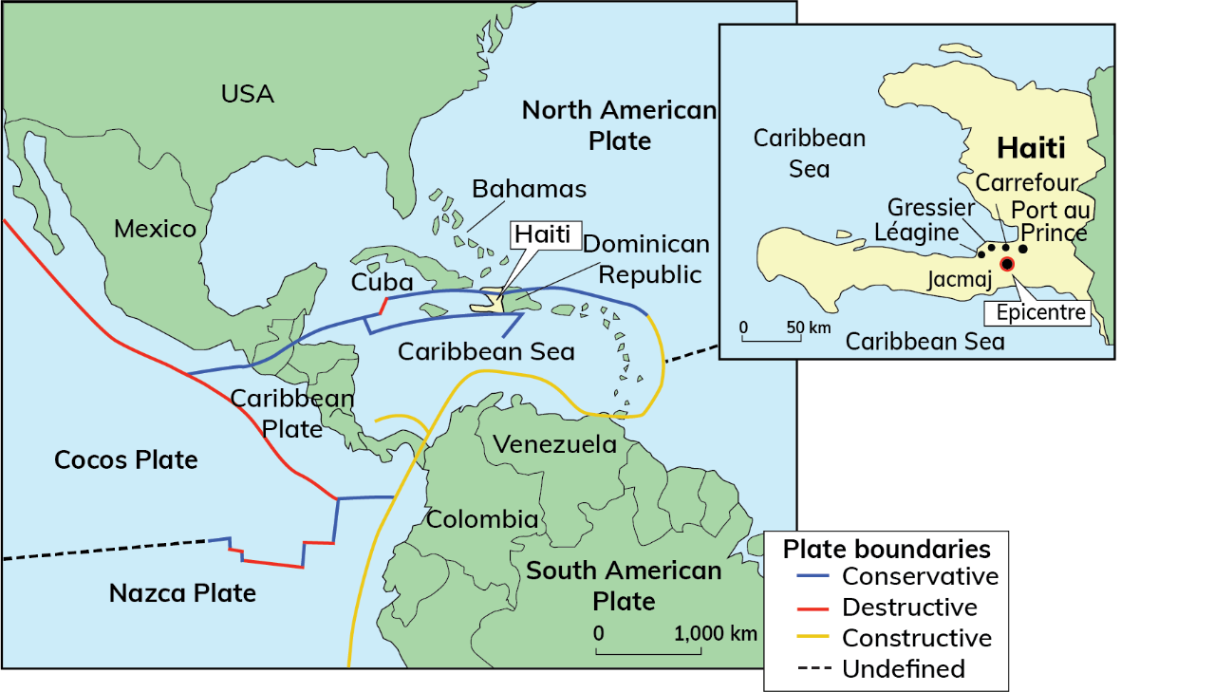
3.4 Describe the economic and social impact of earthquakes.
Haiti, 12 January 2010
Haiti is located in the Caribbean.
It is a very poor country with a population of 10 million.
Its capital, Port-au-Prince, was struck by an earthquake that reached 7.0 on the Richter scale.
Much of the city was reduced to rubble.

Slide 21
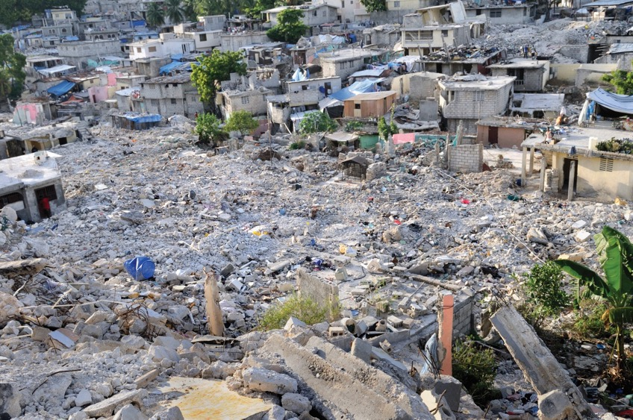
3.4 Describe the economic and social impact of earthquakes.
Look at this image of collapsed houses in Haiti.
1. Why do you think these houses collapsed?
2. What is the connection between the quality of buildings and earthquake damage?

Slide 22
3.4 Describe the economic and social impact of earthquakes.
Social impacts
Poorly constructed houses collapsed and one million people were left homeless.
230,000 people were killed.
All Haiti’s hospitals were damaged or destroyed.
A prison was destroyed, releasing 4,000 inmates.
Water, electricity and sewerage systems were damaged.
Poor sanitation led to an outbreak of waterborne diseases, e.g. cholera.
Seaport and airport were destroyed, delaying aid agencies offering help.
Violence and looting broke out.

Slide 23
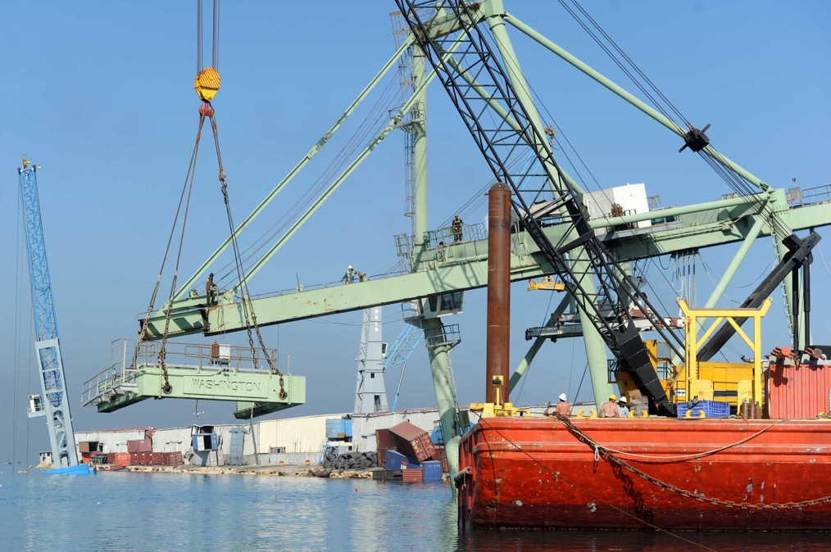
3.4 Describe the economic and social impact of earthquakes.
Look at the image below showing Haiti’s main port at Port-au-Prince after the earthquake.
1. Describe the damage shown in the photograph.
2. What were the implications of the destruction of the port for Haiti?

Slide 24
3.4 Describe the economic and social impact of earthquakes.
Economic impacts
Seaport and airport were destroyed, key communication links.
Roads were blocked which led to difficulties getting aid in.
Important historical buildings were destroyed, e.g. National Palace.
250,000 homes and 30,000 commercial buildings were destroyed.
The UN appointed Bill Clinton, former US President, to coordinate relief efforts that would be needed for many years – not only to rebuild the country’s infrastructure but also its economic development.

Slide 25
3.4 Describe the economic and social impact of earthquakes.
Go to Section 3.4 on page 11 of your Skills Book.

Slide 26
3.5 Describe short-term and long-term responses to earthquakes.
Short-term effects
Deaths and injuries
Buildings – homes, offices, factories – are damaged and collapse
Infrastructure disrupted or destroyed – water and sewerage pipes burst, electricity and telephone cables snap, gas pipes break, causing fire
Roads crack and collapse, railway lines bend, harbour walls break
Cost of emergency aid

Slide 27
3.5 Describe short-term and long-term responses to earthquakes.
Short-term responses
Initiate search-and-rescue to find survivors, bury those who have died.
Provide medical help in field hospitals to injured survivors.
Provide emergency food, water and shelter for survivors.
Clear roads and provide transport so that aid can be delivered.
Provide information points to help people find loved ones.
Organise aid programmes.

Slide 28
3.5 Describe short-term and long-term responses to earthquakes.
Long-term effects
Bereavement, as people live with the loss of loved ones
Fear, as people live with the uncertainty of future earthquakes
Jobs lost, as businesses are disrupted
Homelessness while people await the reconstruction of their homes
Homes, factories and offices need services to be repaired – this takes time
Roads need to be reconstructed
Cost of rebuilding

Slide 29
3.5 Describe short-term and long-term responses to earthquakes.
Long-term responses
Provide housing support while rebuilding homes.
Support businesses to reopen and rehire workers.
Repair roads, bridges, ports and airports.
Ensure that all buildings are earthquake-resistant.
Repair water and sewerage pipes.
Rebuild electricity and telephone lines.
Provide counselling support for survivors.
Invest in prevention of earthquake damage.

Slide 30
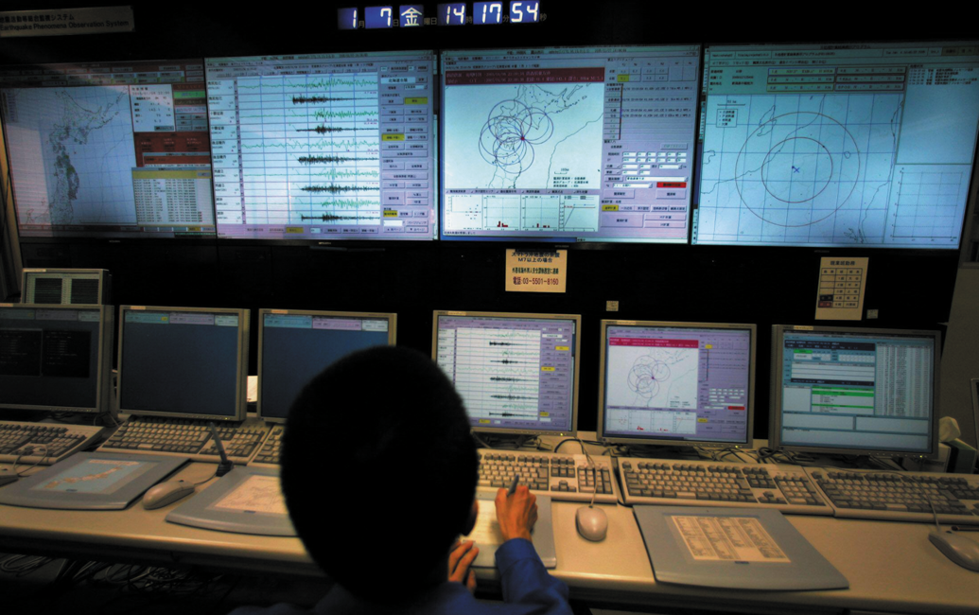
3.5 Describe short-term and long-term responses to earthquakes.
Preventing earthquake damage
1. Predicting earthquakes
we can predict where earthquakes can occur, e.g. plate boundaries, but we cannot predict when.
Laser monitoring ground movement the release of radon gas & animal behaviour are all used to try to predict earthquakes.
Image: Reuters/Alamy Stock Photo

Slide 31
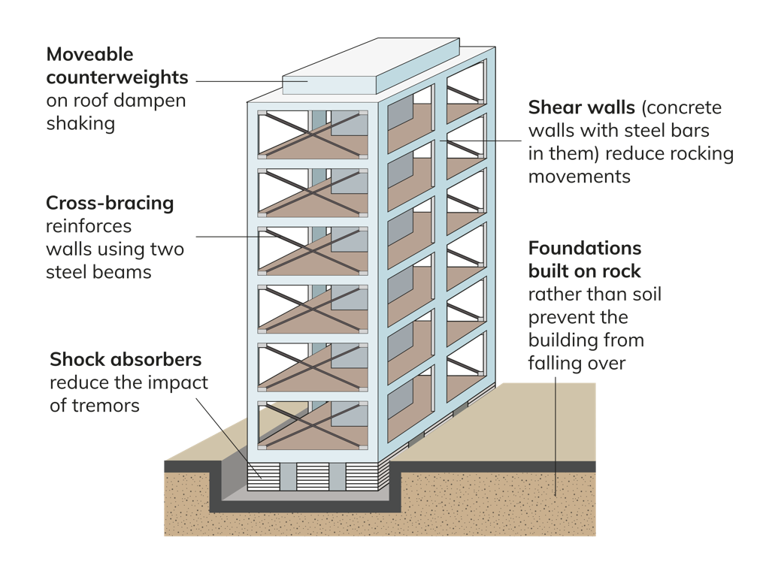
3.5 Describe short-term and long-term responses to earthquakes.
Preventing earthquake damage
2. Planning
Government help to limit the effects of earthquakes by strict planning laws, e.g. earthquake-proof building regulations.
3. Preparation
In Japan, schoolchildren have ‘duck, cover and hold’ routines and most governments organise search-and-rescue personnel with trained sniffer dogs. Emergency supplies are on hand in these areas as well.

Slide 32

3.5 Describe short-term and long-term responses to earthquakes.
1. Why did so many people die in the Haiti earthquake?
2. List two economic impacts and two social impacts of the Haiti earthquake.
3. Describe two short-term responses and two long-term responses to earthquakes.
4. Describe three ways we can limit earthquake damage.
5. Why is search and rescue so important?

Slide 33
3.5 Describe short-term and long-term responses to earthquakes.
Higher-order questions 3
1. Why do Irish schoolchildren usually not practise ‘duck, cover and hold’?
2. Why is it important to rescue survivors as quickly as possible, even if they have been uninjured?
3. Can buildings be earthquake-proof?

Slide 34
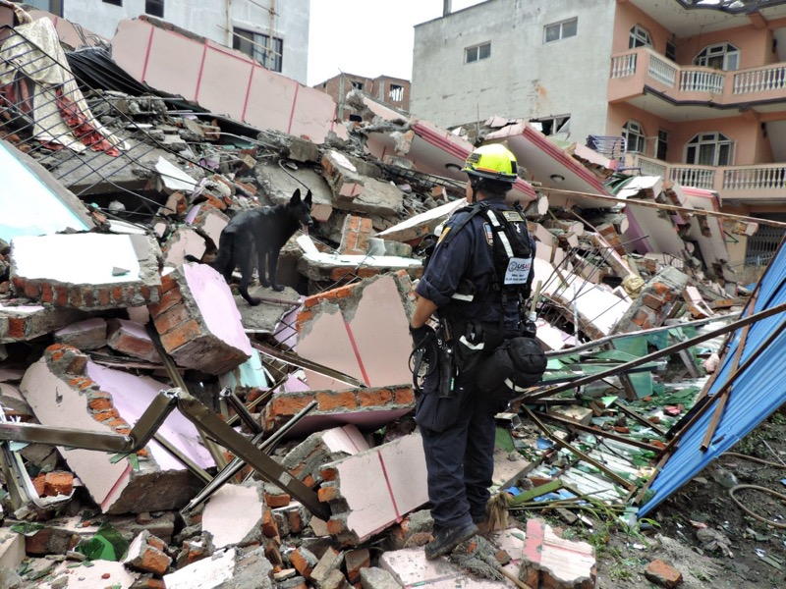
Responding to natural disasters
A natural disaster is an event resulting from natural Earth processes such as earthquakes, volcanoes, floods or hurricanes, which cause enormous damage to property or lives.
**NOTE
Tectonic activity natural disasters: earthquakes, volcanoes, tsunamis
Weather & climate natural disasters: floods, hurricanes , drought, heatwave
Other: avalanche?

Slide 35
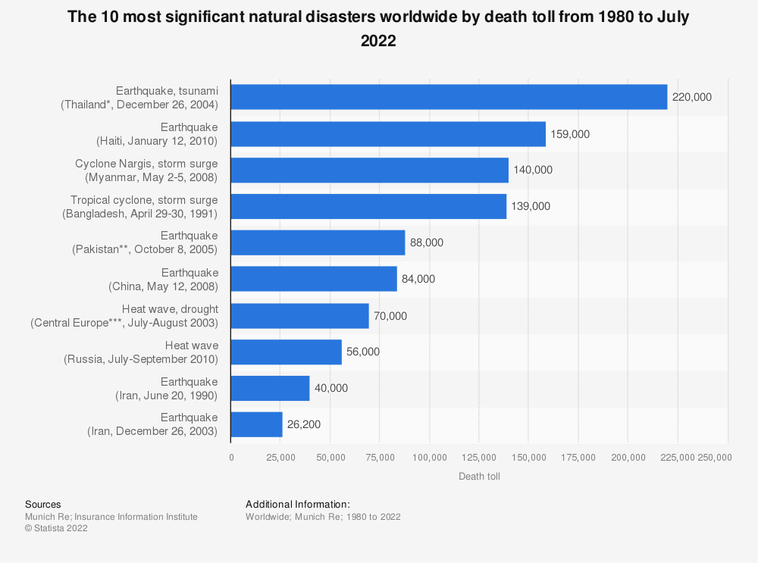

Slide 36
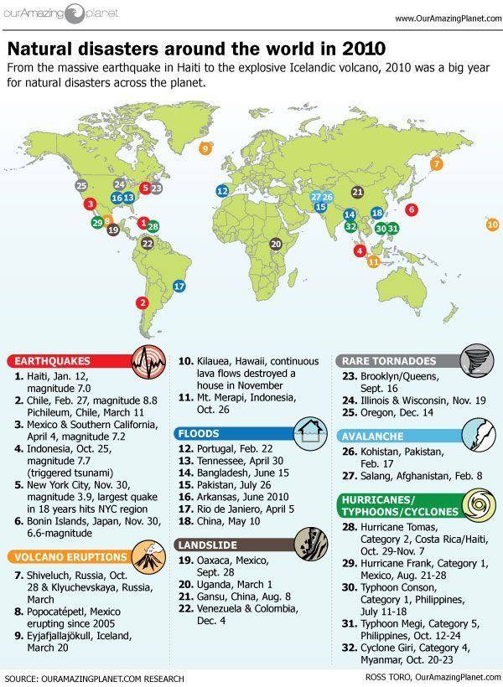

Slide 37
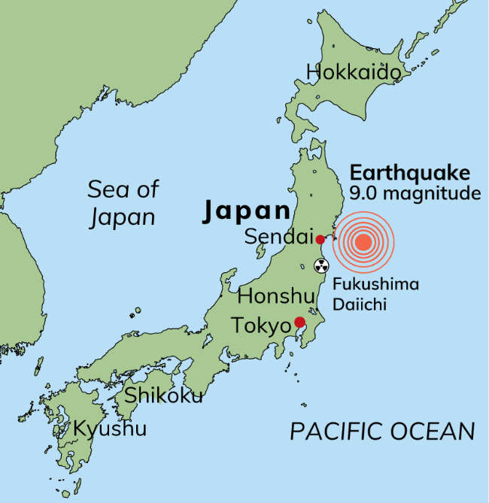
Responding to natural disasters
CASE STUDY
Tsunami at Sendai, Japan: 11 March 2011
An earthquake measuring 9 on the Richter scale occurred in the Pacific Ocean 70 km off the coast of Tohoku, Japan.
It had a depth of 15 m.
It caused a major tsunami with waves over 40 m high.
Earthquake and tsunami caused extensive damage; CCTV footage from northern Japan showed huge waves crashing ashore, tossing vehicles aside and uprooting houses, all of which were carried inland.

Slide 38
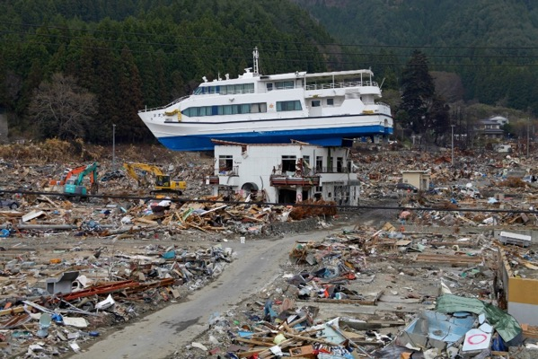
Effects of tsunami at Sendai, Japan: 11 March 2011
16,000 people were killed and 25,000 people were injured.
3,000 people were reported missing.
60,000 people had to be relocated from the area.
Approximately 200,000 buildings were destroyed or damaged.
Over 300 fishing ports were destroyed.
As the water returned to sea, it swept away buildings, cars, people and debris.
A state of emergency was declared following explosions at the Fukushima Daiichi Nuclear Power Plant. The power plant was built to withstand an earthquake but not a tsunami as large as the one that occurred.
The cost of repairs was estimated $300 billion USD, but it will take many years before the area recovers.
Notes:
https://www.google.com/search?q=explosions+at+the+Fukushima+Daiichi+Nuclear+Power+Plant.&rlz=1C1CHBF_en&source=lnms&tbm=vid&sa=X&ved=2ahUKEwiZoq7xscT8AhULS8AKHeWWCM4Q_AUoA3oECAEQBQ&biw=1366&bih=625&dpr=1&safe=active&ssui=on#fpstate=ive&vld=cid:27c77d63,vid:OO_w8tCn9gU

Slide 39
How Japan responded to the disaster
Short-term
Search-and-rescue teams attempted to find survivors.
Field hospitals were set up to treat injured people.
The army provided emergency food, water and shelter to people made homeless.
Emergency measures were taken to limit the damage at the Fukushima Daiichi Nuclear Power Plant, including piping water onto the plant to cool it down.
Long-term
The government set up a committee to organise and manage a rebuilding programme.
Debris from the tsunami (25 million tonnes) was gathered and stored before being incinerated.
Nuclear waste from the damaged power plant was stored. An exclusion zone was established around the plant due to radioactivity.
New 18 m sea walls along the coast were built.
Transport and services were restored, including railways and motorways.

Slide 40
3.5 Describe short-term and long-term responses to earthquakes.
Complete the CBA1 Warm-Up on page 29 of your Textbook.

Slide 41
3.5 Describe short-term and long-term responses to earthquakes.
Go to Section 3.5 on page 11 of your Skills Book.

Slide 42
Assess your progress
Go to page 12 of your Skills Book and assess your progress.
3.1 Describe and explain earthquake activity.
3.2 Describe the distribution and measurement of earthquakes.
3.3 Compare two different earthquakes.
3.4 Describe the economic and social impact of earthquakes.
3.5 Describe short-term and long-term responses to earthquakes.
Identify any gaps in your learning. Use the Rapid Revision on page 31 of your Textbook to jog your memory.

